Slide 1

COVID-19 Twitter:
Misinformation Lookup
An investigation of relevance ranking methods
Swati Adhikari, Provakar Mondal, Kiet Nguyen
CS 5604, 12/8/2021

Slide 2
Motivation: Covid-HeRA (COVID-19 Health Risk Assessment)
Arkin Dharawat, Ismini Lourentzou, Alex Morales, and ChengXiang Zhai. “Drink bleach or do what now? Covid-HeRA: A dataset for risk-informed health decision making in the presence of COVID19 misinformation.” arXiV, 2020.
Classification dataset for COVID-19 misinformation severity
Contains fact-checked news articles and claims, and tweets that refer to them
Misinformation ranked on a severity scale
Labels:
0: Real News/Claims
1: Not severe, 2: Possibly severe, 3: Highly severe
4: Refutes/Rebuts

Slide 3
Covid-HeRA: An example
Fake claim:
Tweets related to fake claims:
Label data:
index | fact_check_url | title
100001 | medicalnewstoday.com | “COVID-19 is just like the flu”
index | tweet_id | tweet | (metadata)
100001 | 1256215023619390000 | “Guys, Covid-19 is just like the flu. A special, magic flu, that kills more people in two months than regular flu kills in an entire year.” | ...
label | index | tweet_id
4 | 100001 | 1256215023619390000

Slide 4
Information Retrieval with Covid-HeRA?
Search engine to look up COVID-19-related tweets and their related corresponding severity label
Help users understand public sentiment about the pandemic related to a subtopic (e.g. drinking bleach?)
Also make informed decisions about a subtopic, provided the tweets and their severity labels

Slide 5
Covid-HeRA (COVID-19 Health Risk Assessment)
Query
Fake claim:
Tweets related to fake claims:
Label data:
index | fact_check_url | title
100001 | medicalnewstoday.com | “COVID-19 is just like the flu”
index | tweet_id | tweet | (metadata)
100001 | 1256215023619390000 | “Guys, Covid-19 is just like the flu. A special, magic flu, that kills more people in two months than regular flu kills in an entire year.” | ...
Document
label | index | tweet_id
4 | 100001 | 1256215023619390000

Slide 6
Covid-HeRA (COVID-19 Health Risk Assessment)
Query
Fake claim:
Tweets related to fake claims:
index | fact_check_url | title
100001 | medicalnewstoday.com | “COVID-19 is just like the flu”
index | tweet_id | tweet | (metadata)
100001 | 1256215023619390000 | “Guys, Covid-19 is just like the flu. A special, magic flu, that kills more people in two months than regular flu kills in an entire year.” | ...
Document

Slide 7
Covid-HeRA (COVID-19 Health Risk Assessment)
Query
Fake claim:
Tweets related to fake claims:
index | fact_check_url | title
100001 | medicalnewstoday.com | “COVID-19 is just like the flu”
index | tweet_id | tweet | (metadata)
100001 | 1256215023619390000 | “Guys, Covid-19 is just like the flu. A special, magic flu, that kills more people in two months than regular flu kills in an entire year.” | ...
Document
⇒ BINARY RELEVANCE RANKING

Slide 8
Project Overview
We have implemented the following three models to do the relevance ranking on Twitter datasets.
Traditional method - BM25
Deep Learning - RankNet
Learning to Rank - TF-Ranking
After implementing the models, our goal is to compare the performance of these three models.

Slide 9
Project Overview
The evaluation metrics we have used to judge our models are...
Mean Average Precision (MAP): The average precision (AP) is a way to summarize the precision-recall curve into a single value representing the average of all precisions.
Mean Reciprocal Rank (MRR): The Reciprocal Rank (RR) information retrieval measure calculates the reciprocal of the rank at which the first relevant document was retrieved. RR is 1 if a relevant document was retrieved at rank 1, if not it is 0.5 if a relevant document was retrieved at rank 2, and so on.

Slide 10

Data Collection
Twitter does not allow full Tweet/user data to be publicized, only Tweet IDs
⇒ Twitter API
Register for access ⇒ Secret keys to be embedded in HTTP requests to Twitter
Unique challenges:
Rate limit of 900 requests/15 minutes
Tweet preprocessing vs. normal text preprocessing
For LTR models: GloVe 50 word embeddings

Slide 11
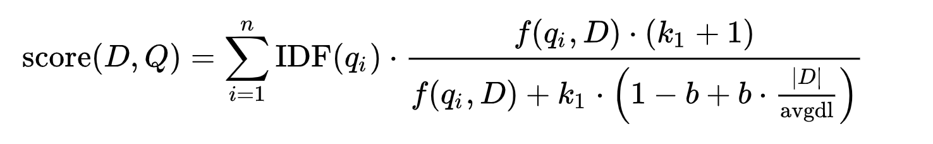
Okapi BM25
A bag-of-words retrieval ranking function
Based on the probabilistic retrieval framework
Given a query Q, containing the words q1,....,qn, the BM25 score of a document D is
Where k1 and b are free parameters, usually chosen, in absence of an advanced optimization, as k ∈ [1.2,2.0] and b = 0.75

Slide 12
RankNet
An overview of the concept of RankNet:
RankNet is a pairwise method that combines all documents under a query into document pairs, and each document pair is used as a sample.
For a query, the model learns probability for a document pair and then the model predicts which document is more relevant to that query.
Also the model calculates cross entropy to fit the true probability and the predicted probability. The closer the two distributions are, the smaller the cross entropy.

Slide 13
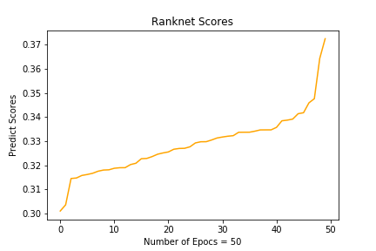
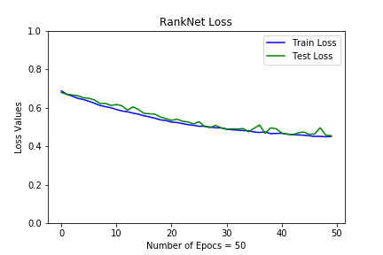
Ranking scores and Loss values from RankNet

Slide 14
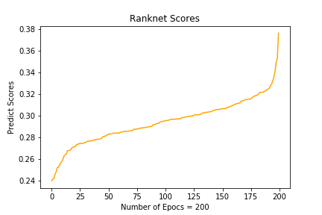
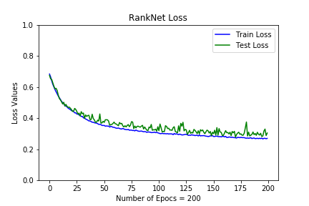
Ranking scores and Loss values from RankNet

Slide 15
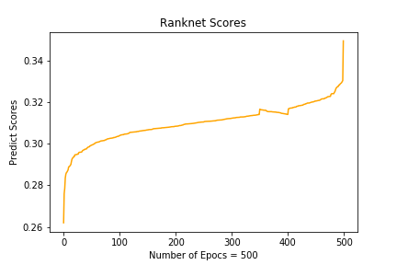
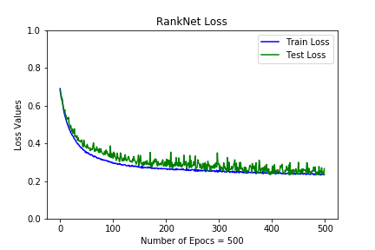
Ranking scores and Loss values from RankNet

Slide 16
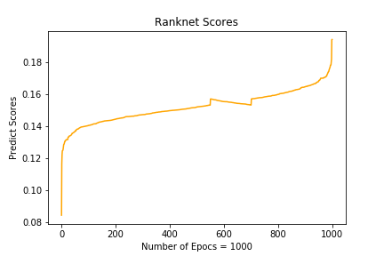
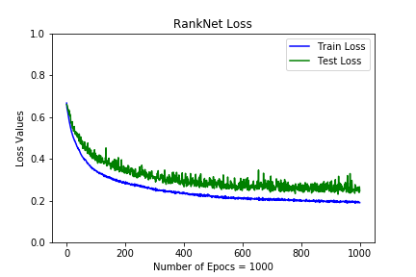
Ranking scores and Loss values from RankNet

Slide 17
Pieces of Info regarding our RankNet
We have used a pytorch implemented RankNet Model.
(This is the reference of our model. We updated some portions of it to work on our dataset and less [train, test loss] and for good ranking scores.
Simple implementation of ranknet pytorch in learning to rank )
These are some super parameters that we have used.
hidden_size = 5
learning_rate = 0.01
For optimizer, we have used Adam
For loss calculation, we have used binary_crossentropy
Mean Average Precision value from RankNet : 0.796088060106243

Slide 18
TF-Ranking
TensorFlow’s TF-Ranking (2019): LTR library containing commonly used loss functions and evaluation metrics
Rama Kumar Pasumarthi et al. “TF-Ranking: Scalable TensorFlow Library for Learning-to-Rank.” KDD 2019.
For our model:
Pairwise logistic loss
1 hidden layer with 16 nodes
Evaluation metrics:
Mean Reciprocal Rank
Mean Average Precision

Slide 19
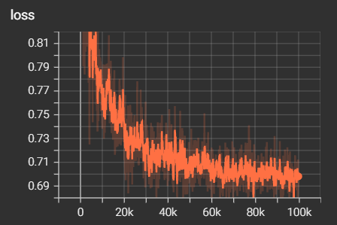
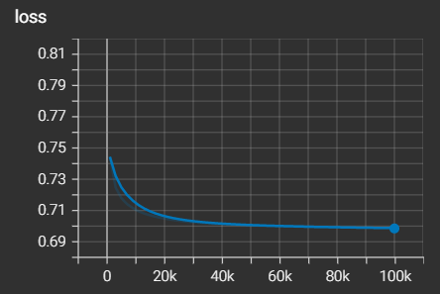
TF-Ranking Performance

Slide 20
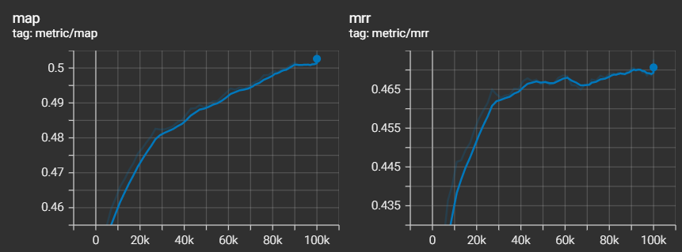
TF-Ranking Evaluation

Slide 21
Next Steps
Fine-tune LTR models for better performance
Error analysis (if they still do not perform well by submission deadline)
Compare the 3 models

Slide 22
Questions?
Thank you for listening!

